Slide 1

OOP
Object Oriented Programming
Lecture 16
Lecture 1

Slide 2
Let’s Discuss the solution of practice questions first

Slide 3
Practice Questions - Question 1
Scenario:
You have a Car class as the base class and a SportsCar class as the derived class. Both classes have a speed member variable, but in the derived class, it’s marked private. You are asked to demonstrate how the different access levels affect member access.
Task:
Create a base class Car with a public member speed and a function showSpeed().
Create a derived class SportsCar that has a private speed member but overrides the showSpeed() function to access the speed member.
Show what happens when trying to access the speed member using objects of Car and SportsCar.

Slide 4
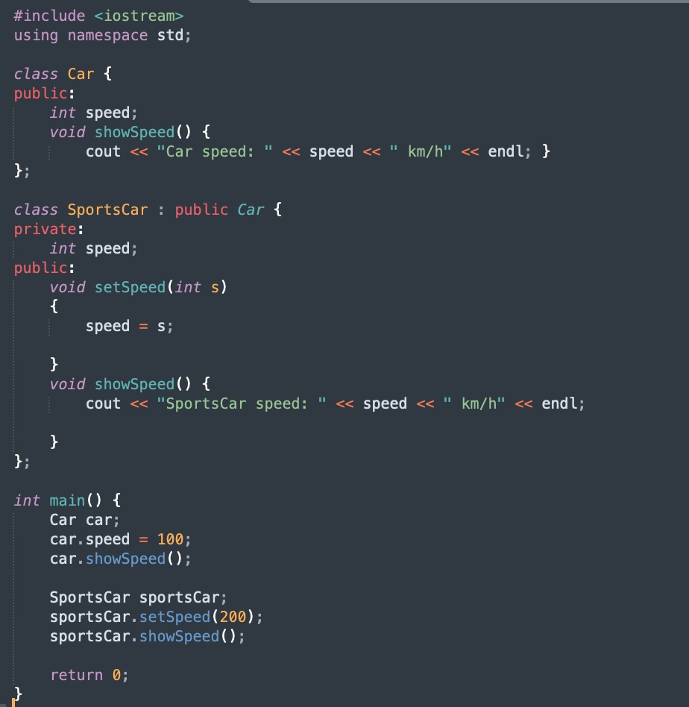
Notes:
Practise question Q1 contains the coode of this

Slide 5
Practice Questions - Question 2
Scenario:
You have a Vehicle class with a protected member fuelLevel, which is inherited by Car. You need to access the protected member from within the derived class and explain what happens when trying to access it using an object of the base class.
Task:
Create a base class Vehicle with a protected member fuelLevel.
Create a derived class Car that has a member function to access and display fuelLevel.
Show what happens when trying to access fuelLevel from an object of Vehicle.

Slide 6
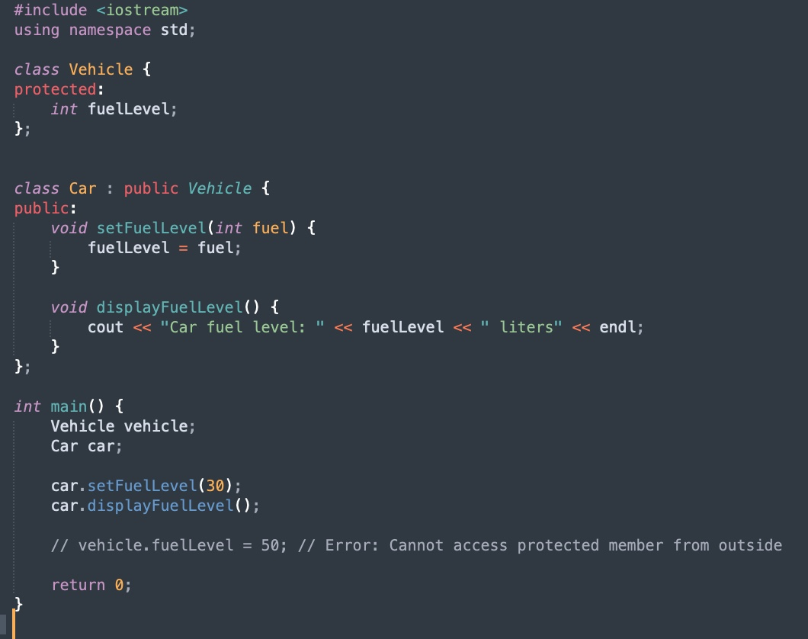

Slide 7
Explaination
fuelLevel as protected:
Accessible in the derived class (Car), but only within its own member functions (e.g., showFuelLevel()).
Not accessible directly in main() or through an object of Vehicle.
Encapsulation:
The Car class does not expose fuelLevel directly as public. Instead, it provides a member function (showFuelLevel()) to display its value, preserving encapsulation.
Invalid Direct Access:
Trying to directly access fuelLevel from an object of Vehicle (e.g., vehicle.fuelLevel) is not allowed because fuelLevel is protected.

Slide 8
Types of Inheritance

Slide 9
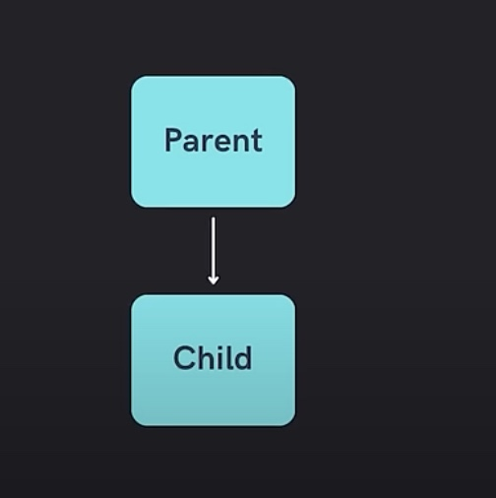
Single Inheritance

Slide 10
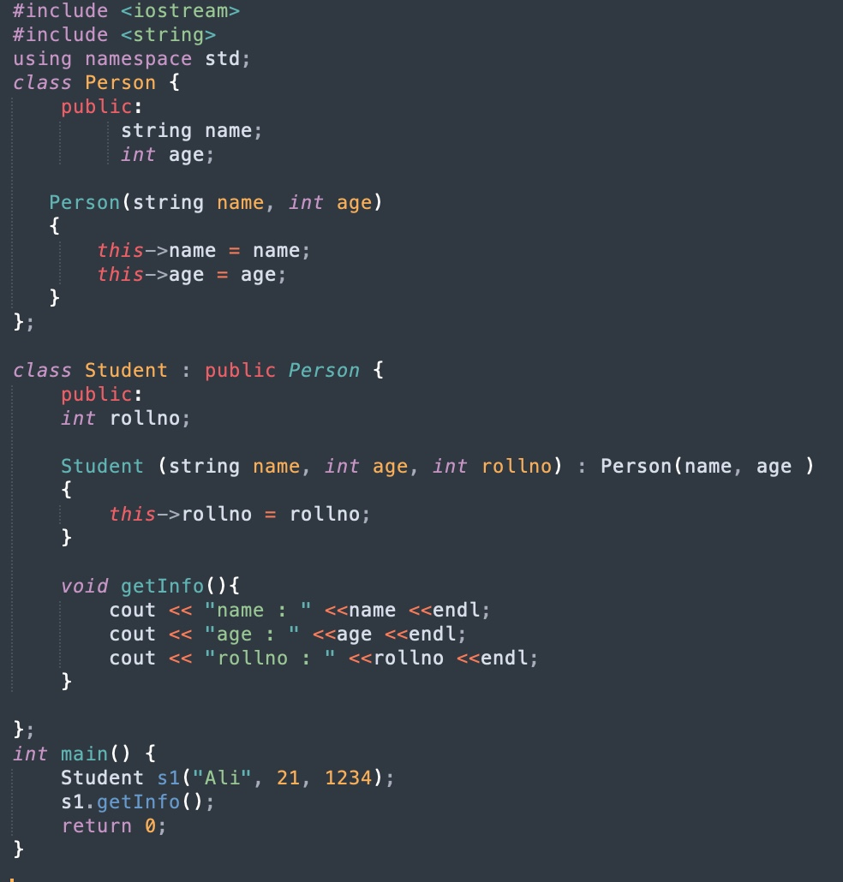
Notes:
Task 3 contains the code of this

Slide 11
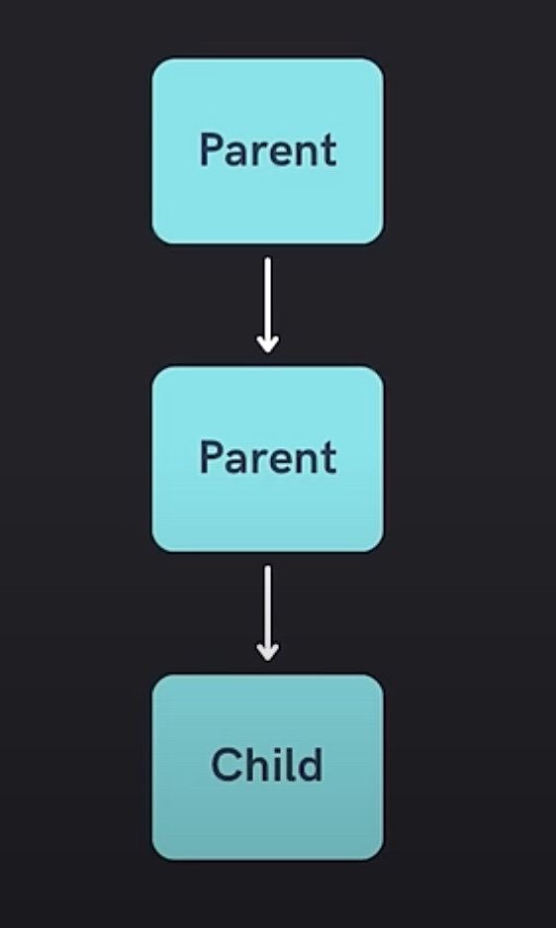
Multi-level Inheritance

Slide 12
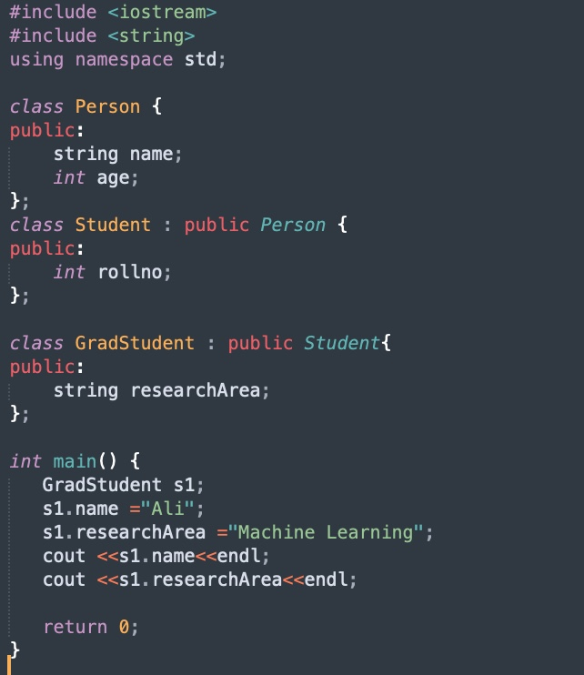
Notes:
Task1 contains this code

Slide 13
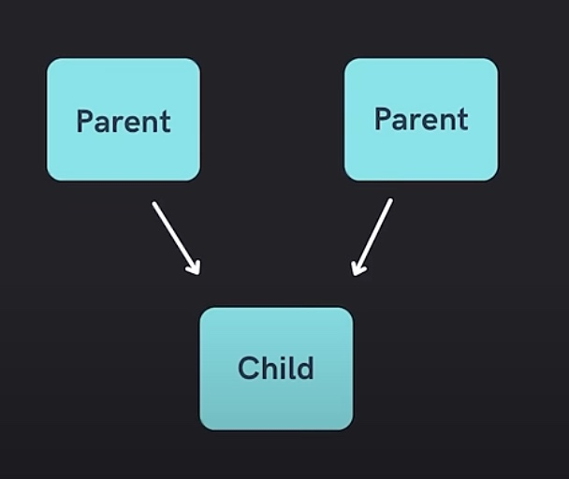
Multiple Inheritance

Slide 14
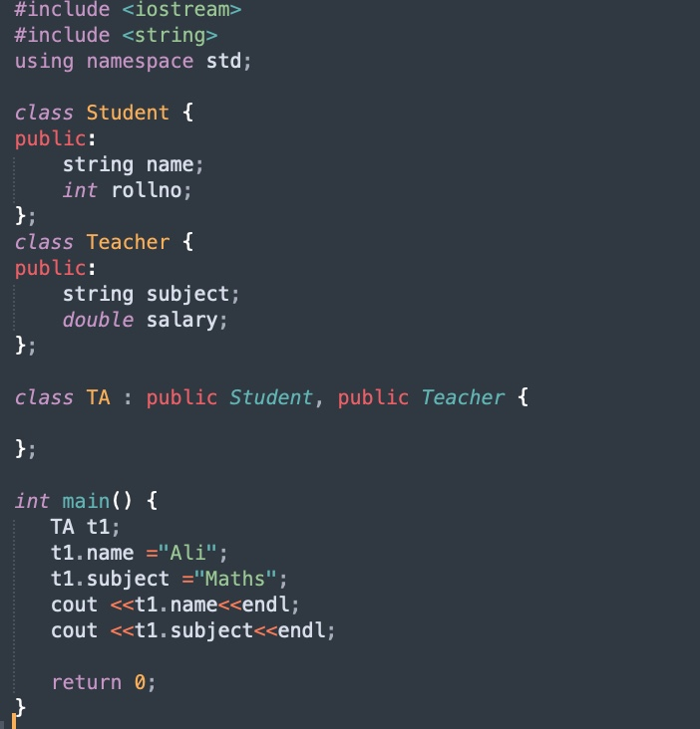

Slide 15
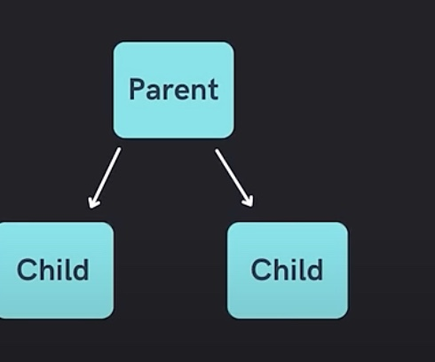
Hierarchial Inheritance

Slide 16
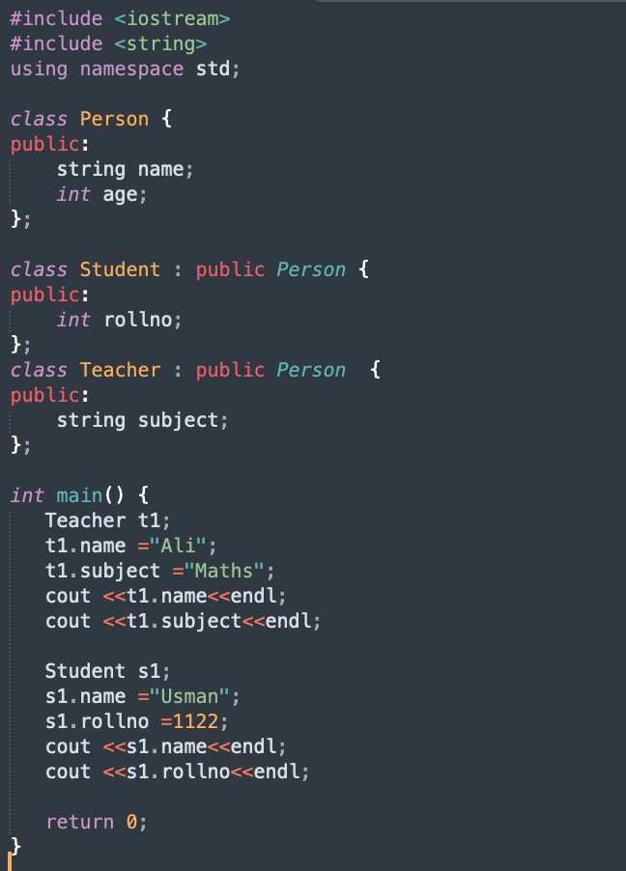
Notes:
Task 3 contains he code of his

Slide 17
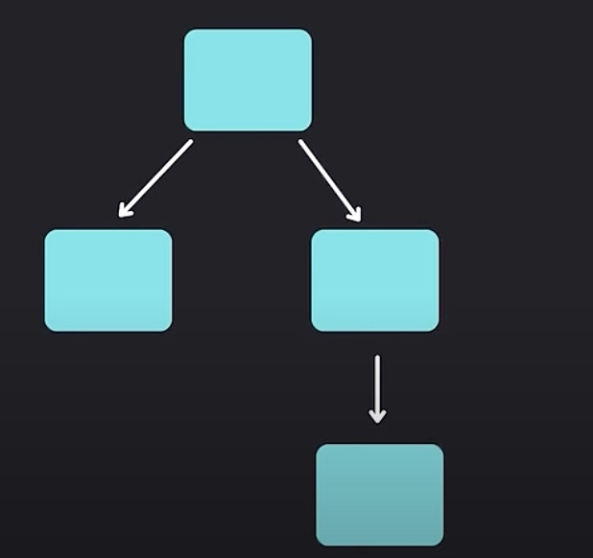
Hybrid Inheritance

Slide 18
Hybrid Inheritance
Now its your task to implement the hybrid inheritance approach

Slide 19
End of Lecture

